Slide 1
Baptist Covenant Theology
A Biblical Framework for understanding and Savoring God’s Unfolding Redemptive work in HIstory
Part 7: Responding to Dispensationalism

Slide 4
Essentials of Dispensationalism
Israel and the church are separate entities and will be so for all eternity.
The Bible should be interpreted literally, in the same way we would interpret any other book.
And I will give to you and to your offspring after you the land of your sojournings, all the land of Canaan, for an everlasting possession, and I will be their God.” Ge 17:8

Slide 5
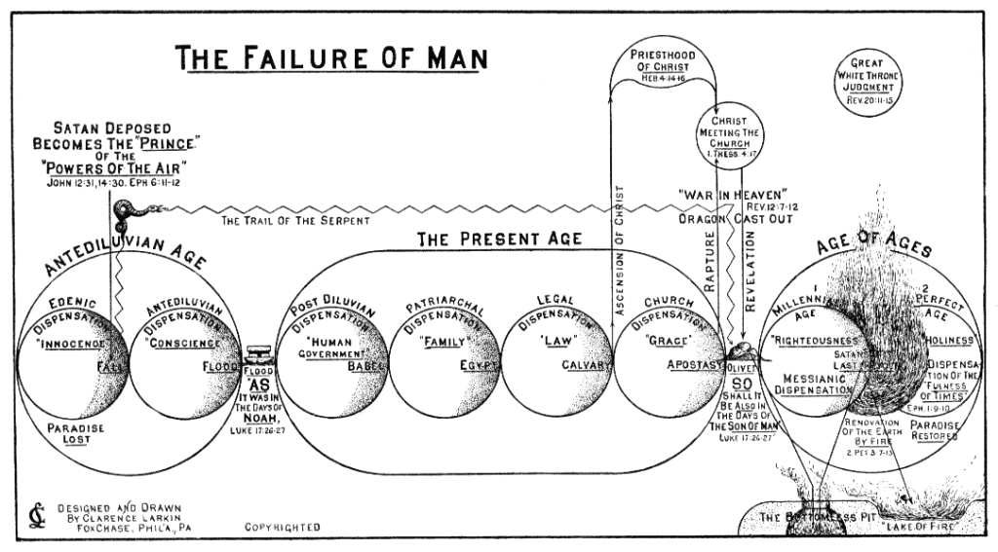

Slide 6
Two Covenants Illustrated in Abraham’s Sons
Hagar/Ishmael
Sarah/Isaac
children of flesh
Mount Sinai (place of the law)
slavery
ironically fruitless
persecuting
temporary
no inheritance
→ old covenant/covenant of works
children of promise
Jerusalem above (place of redemption)
freedom
ironically fruitful
persecuted
eternal
glorious inheritance
→ new covenant/covenant of grace

Slide 7
Baptist Covenant Theology on Israel & the Church
The NT church is a continuation of the OT people of God with universal scope and expanded blessings. The distinction can be compared to the progression from a child to an adult.
The relationship of Israel to the church is like the relationship of the caterpillar to the butterfly.

Slide 8
Baptist Covenant Theology on Interpreting Scripture
Scripture interprets Scripture.
The NT interprets the OT and therefore teaches us how.
Each passage has one meaning.
The meaning of the passage may be beyond the human author’s understanding.
God communicates realities through types and shadows.
God accommodates his expressions.

